Slide 1

Software Engineering
FINAL PRESENTATION
Doctor’s Office
Owned by: Dr. OUJJARI Abdellah
Supervised by: Dr. KETTANI Driss
Team members:
  Nisrine Bnouhanna
  Ouadie Limouni
  Achraff-Nour Meski

Slide 2
Acknowledgment
Special thanks to:
Dr. KETTANI Driss
Dr. OUJJARI Abdellah

Slide 3
Team Members
Engineering & Management
Senior
Ouadie Limouni
Computer Science
Sophomore
Achraff-Nour Meski
General Engineering
Sophomore
Nisrine Bnouhanna

Slide 4
Outline
Introduction to Software Engineering
Project Context and feasibility study
Software Engineering Model and process
Requirement Engineering
Conceptual Process Modeling
Conceptual Data Modeling
Design phase
Graphical User interface
Conclusion

Slide 5
Introduction to Software Engineering
What is Software Engineering ?
Why do we need Software Engineering ?

Slide 6
Project Context
Our Project is about developing an information system that handles the management of a Doctor’s office.
  A doctor’s office that started in 1997
  The owner is Dr. Oujjari Abdellah (Cardiologist)
  The office is located in Meknes

Slide 7
Feasibility Study
Description of the current situation:
Doctor Oujjari manages his office manually with the help of his secretary, by storing information in cards and forms.
Advantages of the new system to be implemented:
  Automation of the business
    Managing Appointments, Patients, Transactions …
    Saving time
    Gaining efficiency

Slide 8
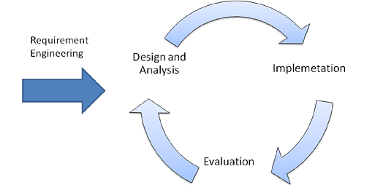
Software engineering model
We used the Incremental Model
  Advantages :
  Good compromise between the waterfall model and the Prototyping model
  Helps anticipating and preventing eventual malfunctioning or unsatisfactoty results

Slide 9
Software Engineering Process
Requirements Engineering
System & Software design
Coding / Programming
Integration and System Testing
Operation and Maintenance

Slide 10
Requirements Engineering
Collecting
Validating
Producing the requirement document
ucing the Requirements Documents
Specifying
Analyzing

Slide 11


Functional Requirements
Manage Patients
  Explore Patients
  Exploit Patients
Manage Employees
  Explore Employees
  Exploit Employees
Manage Accounting Transactions
  Exploit Expanses
  Explore Expanses
  Exploit Revenues
  Explore Revenues
Manage Prescriptions
  Explore Prescriptions
  Exploit Prescriptions
Manage Appointments
  Explore Appointments
  Exploit Appointments
Manage Statistics
  Explore Statistics
  Exploit Statistics

Slide 12
Non-Functional & Domain Requirements
  Non-Functional Requirements :
Technology:
  French interface
  User Friendly Graphical User Interface
Time Constraint: 3 months to develop the software
  Domain Requirements :
Respect the forms used by the doctor

Slide 13
Magic Matrix
 | Data | User | Process
Consistency | X | X | X
Precision | X | X | X
Completeness | X | X | X

Slide 14
System Models
Tools that help analyse the different relations between the data, the users, and the processes.
Merise Approach: Systemic French method that aims at unifying standards and practices in information technology and projects management.

Slide 15
Context Diagram
The Context diagram represents the highest level view of the system’s workflow
  It allows us to get a general view of all the interactions between data, users, and processes.
Merise symbolism and Semantic:
Stands for process
Stands for data store
Stands for user

Slide 16

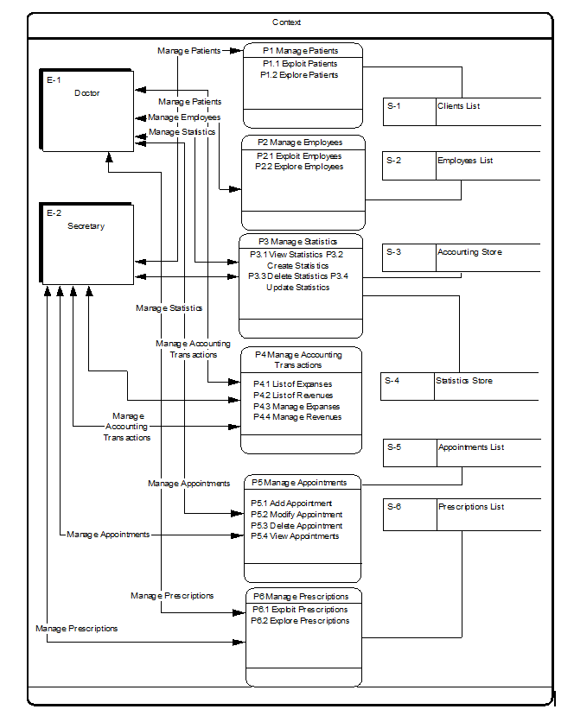
Context Diagram

Slide 17
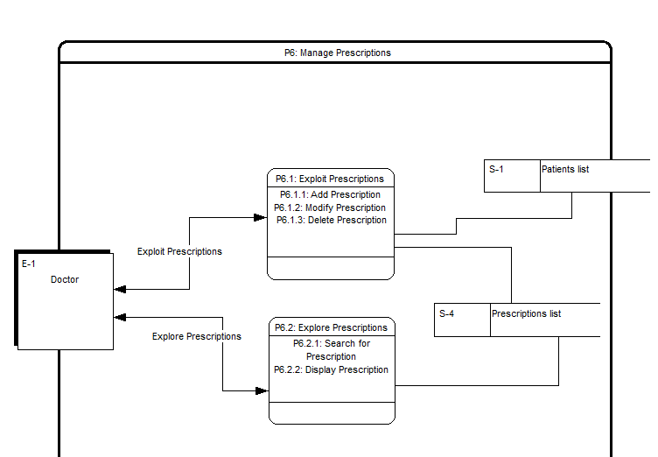
Conceptual Process Models
Exemple: Manage Prescriptions

Slide 18
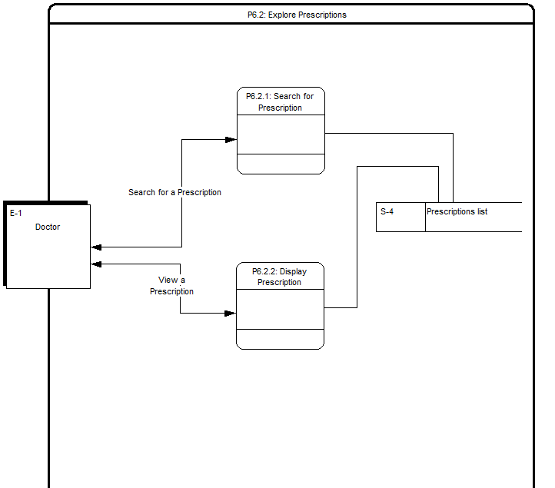
Conceptual Process Models
Explore Prescriptions

Slide 19
Conceptual Architecture
Doctor's Office
Manage Patients
Explore Patients
Exploit Employees
Add Employee
Remove Employee
Explore Employees
View Employee
Search for Employee
Manage Statistics
View Statistics
Create Statistics
Delete Statistics
Update Statistics
Search Stats
Manage Accounting Transactions
List of Expenses
List of Revenues
Manage Expenses
Manage Revenues
Manage Appointments
Add Appointment
Manage Prescriptions
Exploit Prescriptions
Explore Prescriptions
Search for prescription
Display Prescription
Exploit Patients
Manage Employees
View patient
Add Patient
Remove Patient
Modify Patient
Sort Patient
View all Patients
Search for Patient
Modify Employee
Sort Employee
View all Employees
Search Stats
Clients' Stats
Search Stats
Display Stats
Sort Stats
Sells' Stats
Expenses' Stats
Sort Stats
Delete Stats
Modify Stats
Modify Stats
Monthly
Weekly
Monthly
Weekly
Monthly
Weekly
Monthly Expenses
Monthly Revenues
Add Expenses
Add Expenses
Semestrial Expenses
Semestrial Revenues
Modify Expenses
Delete Expenses
Delete Expenses
Modify Expenses
Modify Appointment
Delete Appointment
Add Patient's Name
Modify Patient's Name
View Appointment
Add Date
Add Reason
Modify Date
Modify Reason
Add Prescription
Modify Prescription
Delete Prescription

Slide 20
Magic Matrix after the Conceptual process modeling
 | Data | User | Process
Consistency | 20% | 30% | 97%
Precision | 15% | 45% | 97%
Completeness | 10% | 40% | 95%

Slide 21
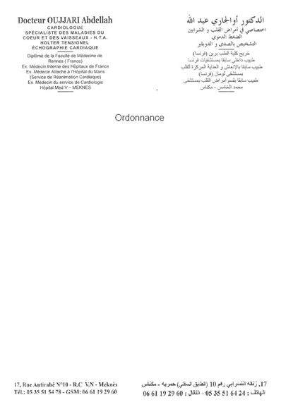
Data Dictionary
Meetings held with the client
Forms used in the doctor’s office
  Ordonnance
  Fiche du Patient
  Renseignements sur les Employés

Slide 22
Data Dictionary
Attribute Name with the corresponding identifier | Form | Attribute Name in English | Description | Inductive/ Deductive | Countable/ Non-Countable
Nom de Patient Nom_Patient | Ordonnance Fiche de Patient Fiche de Rendez-vous | Last Name | last name of the patient | D | NC
Prénom de Patient Prénom_Patient | Ordonnance Fiche de Patient Fiche de Rendez-vous | First Name | First name of the patient | D | NC
Né le: Date_Naissance | Fiche de Patient Renseignements sur les Employés | Birth date | birth date of the patient | D | NC
Addresse Addresse | Fiche de Patient Renseignements sur les Employés | Address | The address of the patient | D | NC

Slide 23
Data Dictionary
Data dictionary anomalies:
  Redundancy: The same set of characters standing for the same meaning appears in many forms
  Homonyms: Same set of characters that appears in different forms but stands for different meaning
  Synonyms: Different names that appear in different forms but stand for the same meaning
Example:
Attribute in French | Proposed Solution to Differentiate
Nom | Nom de patient | Last name of the patient
 | Nom d’employé | Last name of the employee
 | Nom de docteur | Last name of the doctor

Slide 24
Entity Relationship Model
Patient
Identifier
First name
Last name
Phone
Birthdate
Address
Profession
Mutualist
General Info
Medical description
Identifier
Date of visit
Date of next visit
symptoms
Prescriptions
Medical tests
Type of payment
General Info
Appointment
Identifier
Date
Time
Motif
General Info
takes
Has
1,1
0,n
1,1
0,n
Transaction
Identifier
Date
Amount
Type of transaction
Type of payement
General Info
Statistics
Identifier
Date
Type
Value
Type of payement
General Info
1,n
Pay
1,n
Secretary
Identifier
First name
Last name
Phone
Birthdate
Address
General Info
Salary
Waiting List
Identifier
Date
Amount
Type of transaction
Type of payement
General Info
Doctor
Identifier
First name
Last name
Phone
Birthdate
Address
General Info
Create
View
1;1
1,1
0,n
1,1
1,1
View
0,n

Slide 25
The magic matrix after the Conceptual data Model :
 | Data | User | Process
Consistency | 90% | 85% | 97%
Precision | 80% | 90% | 97%
Completeness | 95% | 90% | 95%
Considerable development of the magic matrix

Slide 26
Design Phase

Slide 27



Design
Technology Enablers
Programming Language: Java
The used IDE: JBUILDER
The database tool: Jdatastore

Slide 28
Functional Architecture
Doctor’s Office System
Manage Patients
Add Patient
Modify Patient
View all Patients
View Patient
Drop Patient
Search by: Name or CIN
Sort by: Name or CIN
View an Employee
View all Employees
Add Employee
Delete Employee
Sort Employees by: Name or CIN
Search Employee by: Name or CIN
Modify Employee
Manage Prescriptions
Add Prescription
View Prescription
Manage Statistics
Manage Accounting Transactions
Manage Employees
Modify Prescription
Delete Prescription
Search Prescription
View Statistics
Modify Statistics
Update Statistics
Add an expense
Modify an expense
Delete an expense
View expenses
Manage Appointments
Add Appointment
Modify Appointment
Delete Appointment
Search Appointment
Sort
View
Search Statistics
Sort Prescriptions
Add a revenue
Modify a revenue
View revenues

Slide 29
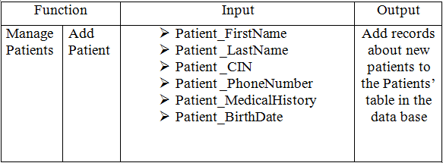
Functions Interface

Slide 30
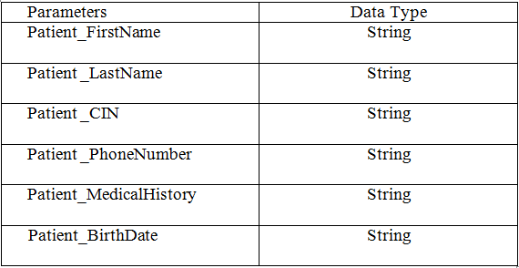

Slide 31
Functions Interactions
Example: Add Patient
Check if the Patient exists or not
Check the validity of the data entered one by one
Enter the attributes of the Patient to be added
Validate the addition of the new Patient
Send the added data to the database
Add Patient
Confirm Addition

Slide 32
Graphical User Interface
User friendly
Simple
User oriented

Slide 33
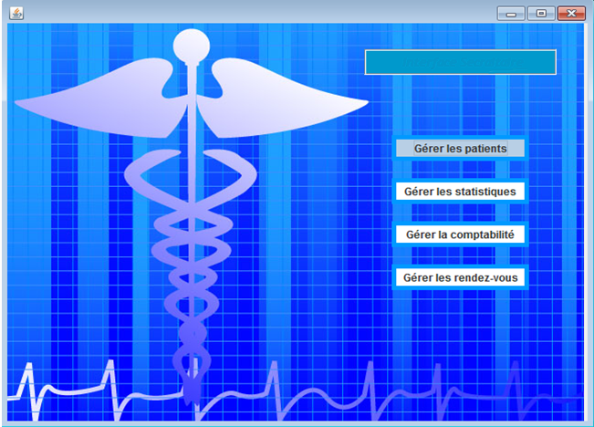
Graphical User Interface
Secretary’s view

Slide 34
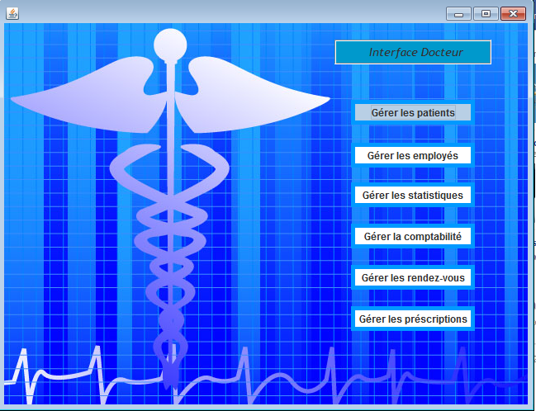
Graphical User Interface
Doctor’s view

Slide 35
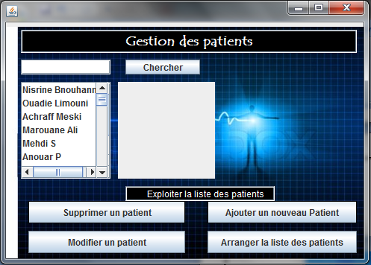
Graphical User interface
Manage Patients Interface

Slide 36
Conclusion
Learning outcomes :
Good understanding of software engineering processes
Acquired experience: real life project
Software engineering team spirit

Slide 37
Thank you for your attention !

